Slide 1
DATATHON
APRIL 2019
One Day Challenge

Slide 2
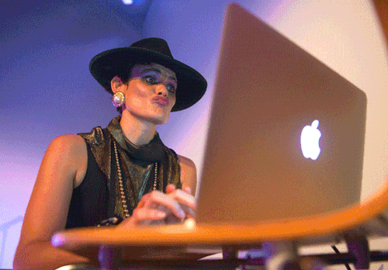
WHAT IS A DATATHON?
A datathon is a one day challenge event where you will use your analytical and technical skills to tackle a given problem.

Slide 3
WHY ARE WE DOING THIS??

Slide 4
GOALS
2 projects per module → Datathon = Mini ML project.
Challenge yourself.
Great learning opportunity.
Learn from team mates.
Have a great time!

Slide 5
SPECIAL GUESTS

Slide 6
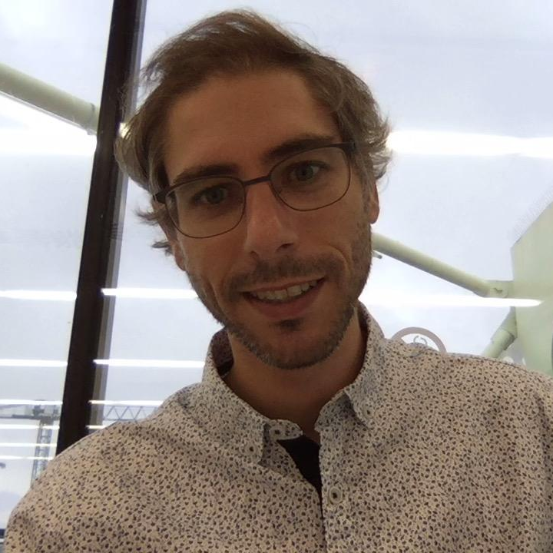
MENTORSHIP
Gabriel Piles
“Data Scientist”

Slide 7
CHALLENGE

Slide 8
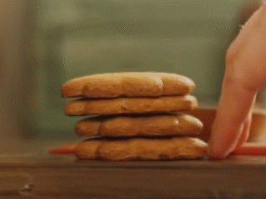
Cookie Flea is in trouble
Cookie Flea is a newcomer distribution company in the cookie industry.
They are losing money

Slide 9

Heavy stock problems
500 cookies types
Cookies from 30 different countries
Shortage for 20% of the cookies
Overstock for 45% of the cookies

Slide 10

Solution: predict using ML each cookie quality before selling it
800 new cookies evaluations each year

Slide 11
They bought a cookies dataset
16 columns with cookies measurements and the quality
The rows are the values of different cookie types

Slide 12
YOUR TASK
Predict the cookies quality using the Cookie Flea dataset.
Present your results at the end of the day!

Slide 13
CONSIDERATIONS

Slide 14

DATABASE
You can find the data here:
driver = 'mysql+pymysql'
ip = '35.239.232.23'
username = 'ironhacker_read'
password = 'ir0nhack3r'
db = cookies

Slide 15

WHAT DO YOU NEED TO DELIVER?
Jupyter notebook with your analysis.
Presentation slides.

Slide 16
NOTEBOOK REQUIREMENTS
You must include a cleaning method.
Include the metric you used to evaluate and your result.
Add comments and descriptions of the steps you take.
Justify each decision you make.
Give the notebook a clear structure.
Clean code!

Slide 17
WHAT ABOUT THE PRESENTATIONS?
Keep presentations under 10 minutes.
Use slides.com or Google Slides.
Present yourselves.
Remember to tell a story!

Slide 18

HOW WILL YOU BE EVALUATED?
Quality of your thinking and analysis.
Technical checkpoints.
Independent test set.
Organization & Teamwork.
Presentation.

Slide 19
CHECKPOINTS

Slide 20
MORNING CHECKPOINT - BY 11:00
Planning
Repository
README file
Data cleaning
Analysis plan
Hypotheses
Questions to investigate

Slide 21
AFTERNOON CHECKPOINT - BY 14:30
Appropriate model selection
Appropriate metric selection
Clean code
Good practices

Slide 22
SCHEDULE

Slide 23
MORNING STAGE
8:30h KICK-OFF & TEAM BUILDING ACTIVITY
11:00h MORNING CHECKPOINT
13:00h LUNCH

Slide 24
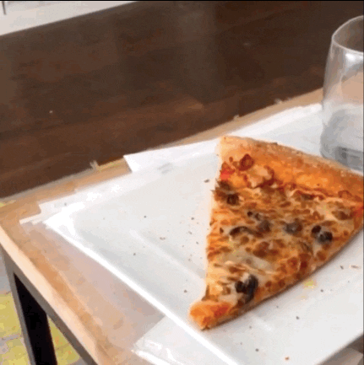
MORNING STAGE
8:30h KICK-OFF & TEAM BUILDING ACTIVITY
11:00h MORNING CHECKPOINT
13:00h LUNCH

Slide 25
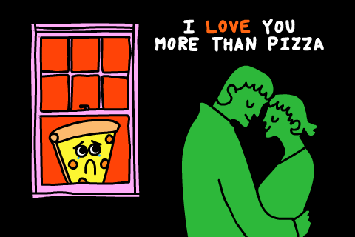
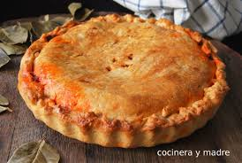
MORNING STAGE
8:30h KICK-OFF & TEAM BUILDING ACTIVITY
11:00h MORNING CHECKPOINT
13:00h LUNCH

Slide 26
AFTERNOON STAGE
14:30h AFTERNOON CHECKPOINT
16:00h CODE DELIVERY
16.20h SLIDES DELIVERY
16:30h PRESENTATIONS !
17:30h BREAK & SURVEY
17:55h WINNER ANNOUNCEMENT

Slide 27
TIPS AND TRICKS

Slide 28

LAST TIPS & TRICKS!
Use a Kanban Board.
Remember: pull and push.
Deliver on time!
Learn from each other.

Slide 29
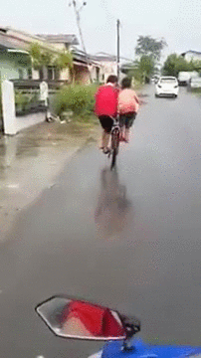
LAST TIPS & TRICKS!
Splitting the work is OK.
You’re stronger together.
WORK FAST, HAVE FUN!

Slide 30
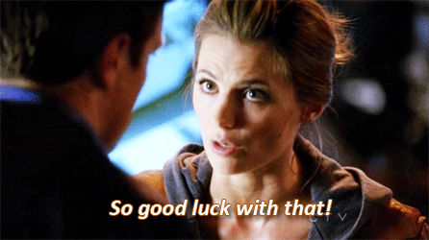

Slide 31

WINNER, WINNER
CHICKEN DINNER

Slide 32
WINNING CATEGORIES
Best Overall
Honorable Mention

Slide 33
WINNING CATEGORIES
Honorable Mention
5 POINTS !!!

Slide 34
WINNING CATEGORIES
Best Overall
15 POINTS !!!

Slide 35
Now….
DO YOU WANT TO MEET YOUR TEAM FOR THE DAY?

Slide 36
TEAM 1
Pau Sampietro
Chun Sang Ngai
Jordi Bayer

Slide 37
TEAM 2
Adrià Ferrer
Alejandro Casamajor
David Suñol

Slide 38
TEAM 3
Roger Roig
Nacho Martínez
Adrien Talbot

Slide 39
TEAM 4
Álvaro Fragoso
Vilma Daukantaite
Anna Vidal
Jessie Lee Delgadillo

Slide 40
TEAM BUILDING ACTIVITY
Rock, Paper & Scissors
Attack Defense Edition

Slide 41
LET KELSEY AND EVA SHOW YOU HOW TO PLAY!
Play the regular Rock, Paper & Scissors game.
Did you win? Attack!!
Did you lose? Defense!!
Eliminate the other teams doing relay.

Slide 42
TEAM BUILDING ACTIVITY
Let’s Play!

Slide 43

GOOD LUCK!
If you have any questions please address them to teachers, TA’s & mentors directly.
Also, you can use the cohort’s Slack channel for this event.

